Slide 1
Form 5 Trial Classes
Biodiversity, Bacteria and Viruses

Slide 2

WHO AM I ?
Name: Loh Han Sheng 罗汉胜
Age : 21
Subject that I taught : Biology (SPM and STPM and Foundation), Physics (SPM and STPM), Chemistry (SPM), ENG
Courses in University : MBBS (Bachelor of Medicine, Bachelor of Surgery)
Currently Year 2 student, Distinction in Physiology and Biochemistry, cGPA 3.95 in Foundation, A in Biology, Chemistry and physics, math in SPM
Previously studied in Foon Yew High School
Experienced Tutor in teaching Biology, Biochemistry and English

Slide 3
Biodiversity → Today topics

Slide 4
Learning outcomes
Classification of organisms
Taxanomy Hierarchy
Binomial Nomenclature System
Dichotomous Key
Concept of Biodiversity
Introduction to Microbiology ( what causes your diseases ) → bacteria and viruses
Introduction to Infectious Diseases ( Dengue and Tuberculosis) → Pre U

Slide 5
Taxonomy
The field in biology that involves the classification, identification, and naming of organisms in an organized manner.

Slide 6
Classification of organisms
Archaebacteria
Eubacteria
Protista
Fungi
Plantae
Animalia
Prokaryotes
Eukaryotes

Slide 7
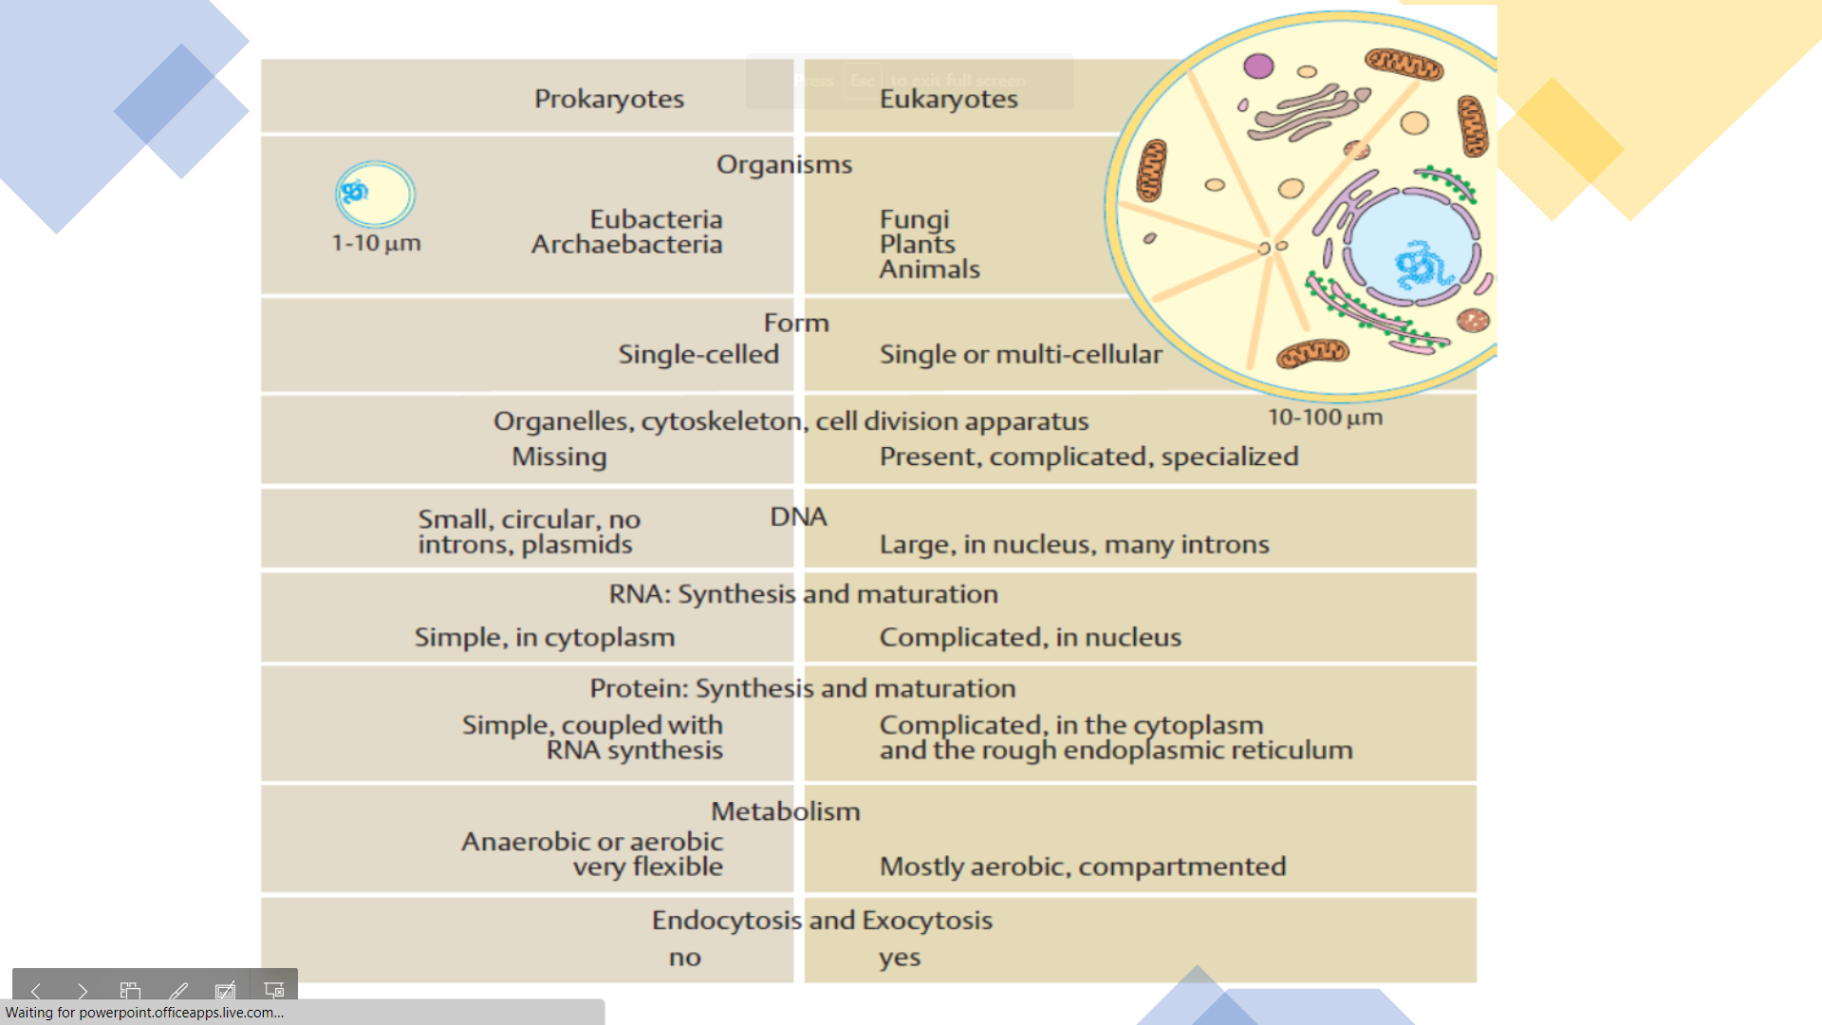
What is the difference between eukaryotes and prokaryotes ?

Slide 8
Archaebacteria
Prokaryotes and primitive bacteria
Unicellular organism
No true nucleus because of lack of nuclear membrane
Can live in extreme environment such as high temperature and high salinity
Has a single circular DNA in the cytoplasm
Uses a flagellum to move, some use cilia
Autotroph or heterotroph

Slide 9
Eubacteria
Prokaryotes and a true bacteria
Unicellular organisms
No true nucleus because lack of nuclear membrane
Has a single circular DNA in the cytoplasm
Use flagellum for movement
Autotroph or heterotroph

Slide 10
Protista
Eukaryotes
Consists of protozoa, algae, slime mould
Most unicellular
Nucleus is enclosed by nuclear membrane
Has a simple cell structure
Can move
Autotroph or Heterotroph

Slide 11
Fungi
Eukaryotes
Plants without chlorophyll
Mostly multicellular but also unicellular such as yeast
Cell wall is made up of chitin not cellulose
Consists of filaments called hyphae that absorb nutrients
Cannot move
Heterotroph

Slide 12
Plantae
Eukaryotes
Multicellular plants
Plants with chlorophyll and are autotrophs
Cell wall is made up of cellulose

Slide 13
Animalia
Eukaryotes
Multicellular animals
Able to move, heterotrophs
Includes vertebrates and invertebrates

Slide 14
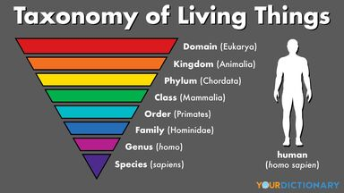
Taxonomy hierarchy

Slide 15
Binomial Nomenclature system
Linnaeus binomial system was introduced by a Swedish botanist called Cari Linnaeus to name organisms scientifically.
Organism is named using 2 Latin names
The first name is the genus name.
The second name is the species name.
Both names are written in Latin, genus name must begin with capital letter while species name must begin with small letter.
They are underlined separately

Slide 16
Examples
Tiger – Panthera tigris
Leopard – Panthera pardus
Lion – Panthera leo
Human – Homo sapiens

Slide 17
Dichotomous key
A dichotomous key is used by taxonomists to identify organisms based on the similarities and differences.
Each key is made up of pairs of contrasting features, starting with general characteristics then move on to specific ones.

Slide 18
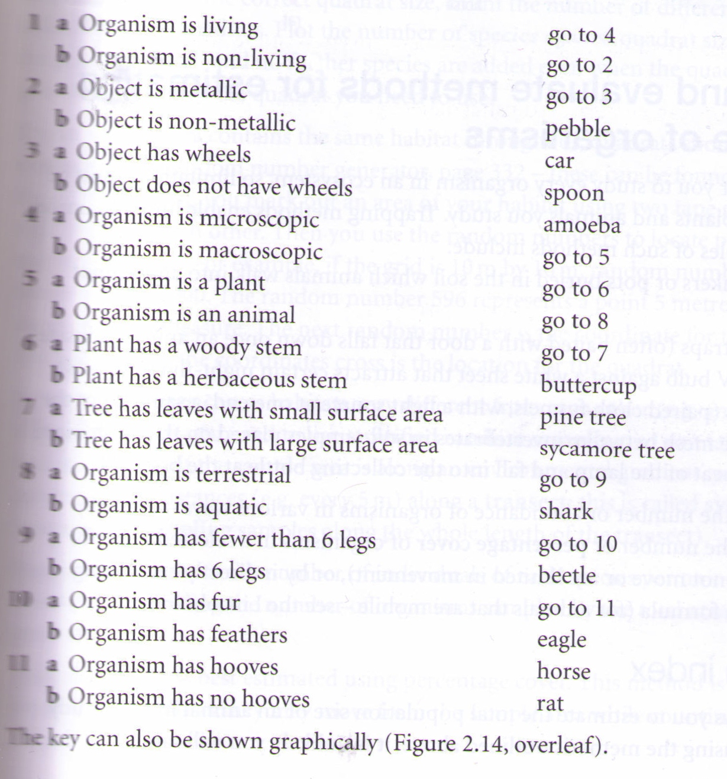
Examples

Slide 19
Examples
1a. Poikilothermic (cold-blooded)………………………………….. Go to 2
1b. Homoiothermic (warm-blooded)………………………………. Go to 4
2a. Has fins but no limbs …………………………………………… Fish
2b. Has four limbs …………………………………………………... Go to 3
3a. Has no scales on body ………………………………………….. Amphibian
3b. Has scales ……………………………………………………….. Reptile
4a. Has feathers ……………………………………………………… Bird
4b. Has fur …………………………………………………………… Mammal

Slide 20
Biodiversity
Variation at genetic, species and ecosystem levels.
Malaysia as one of the mega-biodiversity countries in the world.
Maintains the balance of nature
Provides important pool for plant and animal resources that are of potential use to mankind.
Rich heritage of flora and fauna is important tourist attraction and contributes to the economy of countries.

Slide 21
Introduction to microbiology

Slide 22
Bacteria
Prokaryotes
Unicellular organisms
Some have capsules outside the cell wall
No true nucleus since there is no nuclear membrane
Genetic material in the form of single circular DNA in the cytoplasm
Reproduce asexually by binary fission
Have flagellum for movement
Shapes of bacteria – Coccus, spirillum and bacillus
Examples: Lactobacillus sp., E. coli, Salmonella sp.

Slide 23
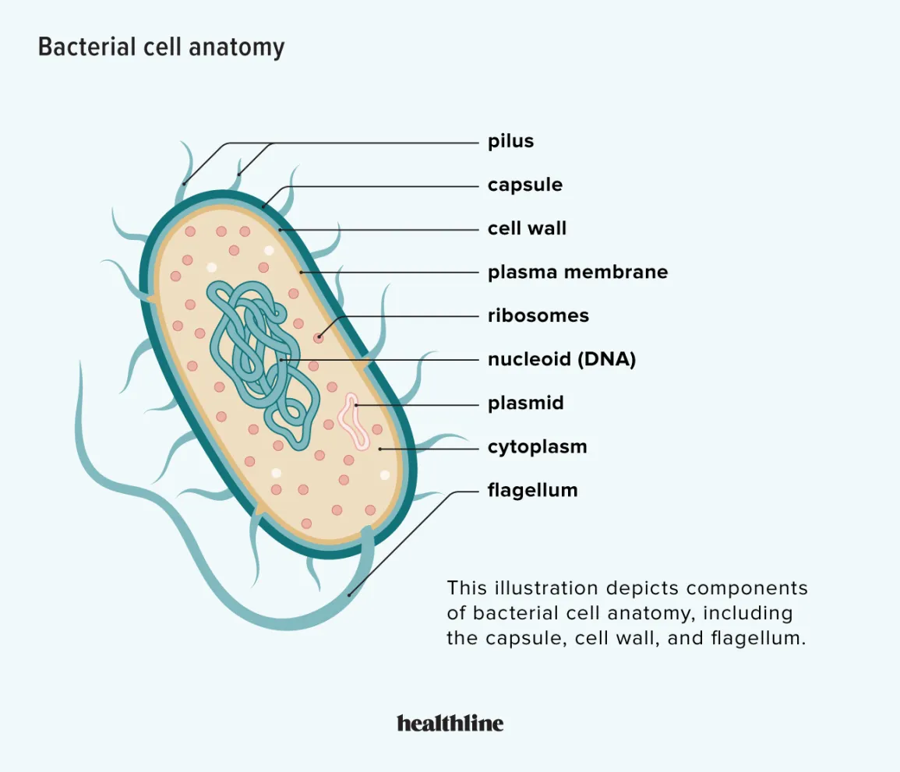

Slide 24
Virus
Non cellular organisms
Can only be seen under an electron microscope
Genetic material is a single strand of nucleic acid: RNA or DNA
Has a protein layer to protect the DNA
No cytoplasm, nucleus or plasma membrane
Shows no characteristics of living things as it has no respiration, nutrition and excretion
Reproduce when the host cell divides
Exists as various forms
Exists as crystals outside the host cells, no sign of life
Cannot be placed in any kingdom since they are not considered as living things
Examples : T4 bacteriophage, influenza virus, tobacco mosaic virus

Slide 25
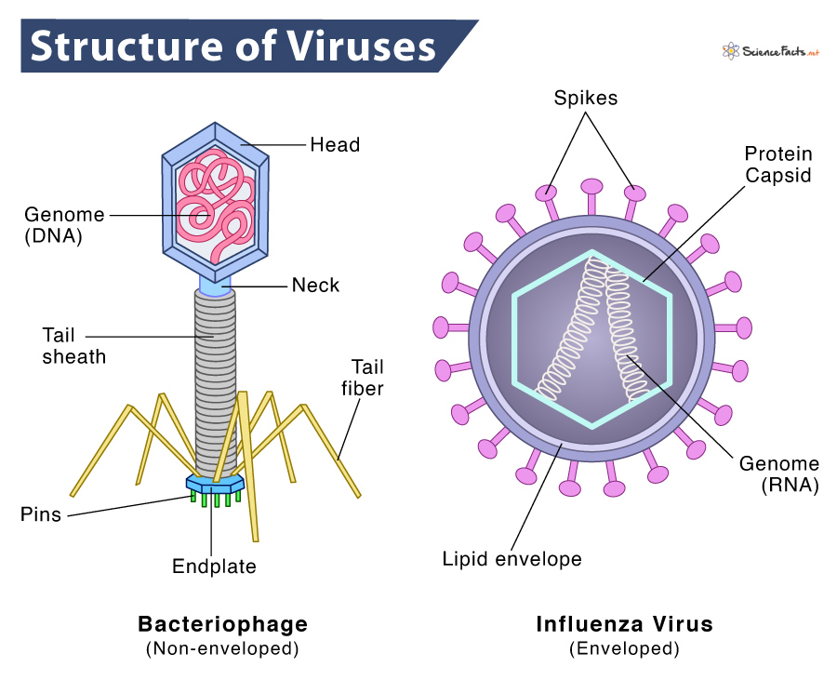

Slide 26
Q: why virus is non-living outside while living inside host cell ?
Virus is non-cellular, they do not have plasma membrane, protoplasm or ribosomes.
They do not self generate energy, undergo respiration and nutrition.
When outside the host cell they exist as particles or crystals, do not show any signs of life.
Once inside the host cell, a virus takes over the metabolic machinery of host cell to replicate itself, indicating the virus is living.

Slide 27
Types of viruses
Based on the type of host they parasite:
  Animal virus
  Plant virus
  Bacteriophage
Based on the genetic material of virus:
  Double stranded DNA
  Single stranded DNA
  Double stranded DNA
  Single stranded DNA

Slide 28
Terms used in infectious diseases
Causative agent / infectious agent
The organism that causes diseases
Carrier
A person who has been infected but does not show any symptoms of the diseases, and can transmit the diseases to others
Incubation period
The period between the time of infection and the appearance of visible signs and symptoms
Signs / symptoms
Visible manifestations of diseases / indicators of diseases (not found by medical examination)
Vector
The organism that transmits the diseases from an infected individual to uninfected one (mosquitoes)

Slide 29
Terms used in infectious diseases
Epidermic
Sudden outbreak of a diseases which spreads rapidly through population and then subsides
Pandemic
A global epidermic, spreads across several continents
Endemic
Diseases that is always present in a particular region but at low level

Slide 30
Dengue
Dengue fever and dengue haemorrhagic fever are caused by the dengue fever virus (DENV), which is a RNA virus.
4 strains of viruses called DENV-1, DENV-2, DENV-3, DENV-4.
Infection with one viral strain is believed to produce life-long immunity to that particular strain. But it is possible to be infected by different strains.
When a female mosquito sucks the blood of an infected human, the virus is ingested into its gut and then moves into its salivary glands, mosquito can transmit the DENV for the rest of its life, the lifespan of mosquito is around 1 month.

Slide 31
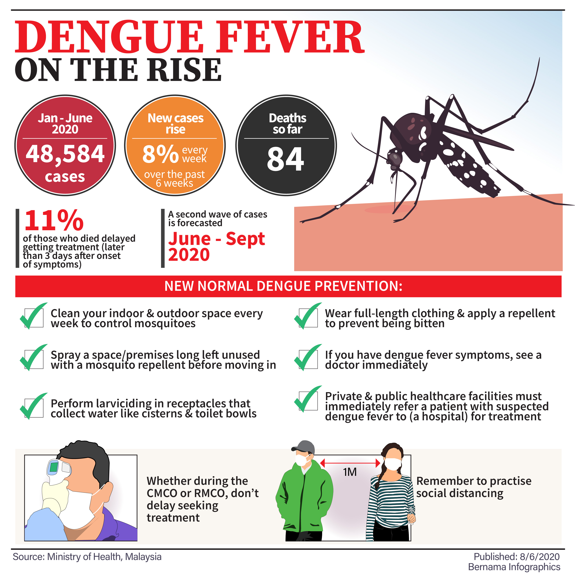
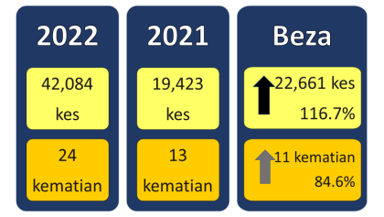

Slide 32
Tuberculosis (TB)
Tuberculosis – 1990 declared as global emergency because of increasing cases in developed countries.
Now the diseases is prevalent in refugee and prisoner-of-war camps.
Resurgence of the diseases is due to
  Drug resistant form of TB appears
  TB/HIV coinfection: people with suppressed or weakened immune systems
  Migration
  Poor housing conditions

Slide 33
Tuberculosis (TB)
It is caused by 2 species of Mycobacterium, a fungus like rod-shaped bacteria, tubercle bacillus and M. bovis which is found in milk.
M. bovis is very resistant and remains active in long periods in milk, but pasteurization and sterilization kill 99% of the bacteria, bovine TB therefore is no longer of threat to humans.
TB is mostly transmitted by droplet infection, but it requires prolonged contact with the patients. Increased risk of contracting TB if the ventilation condition is poor.
Pulmonary TB is the most common.

Slide 34
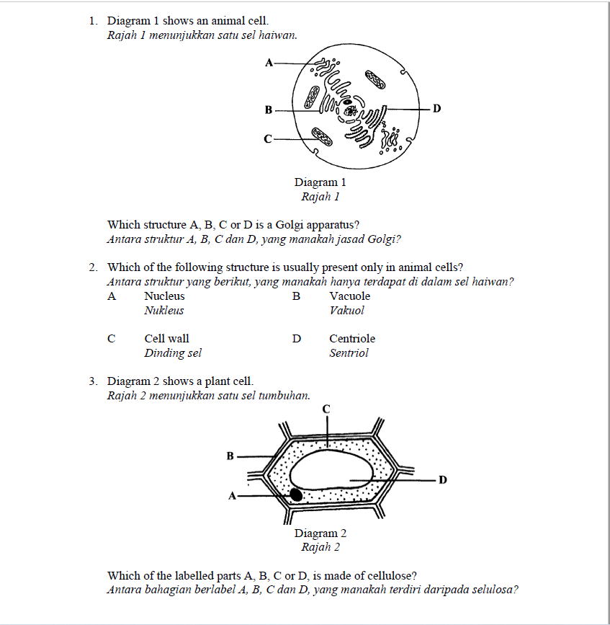

Slide 35
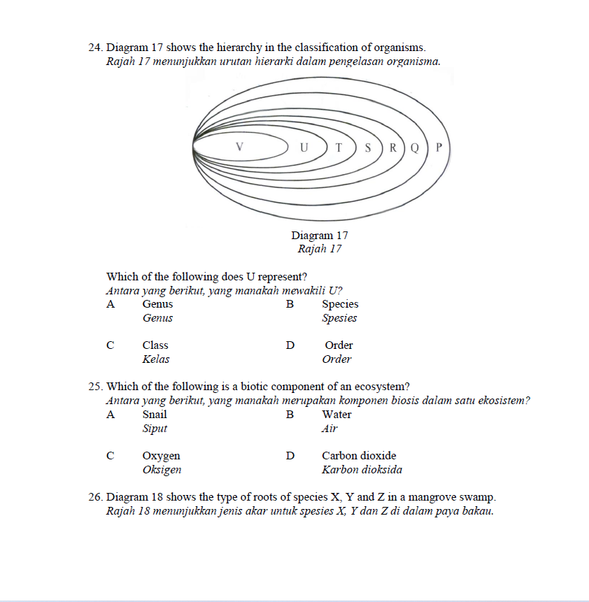

Slide 36
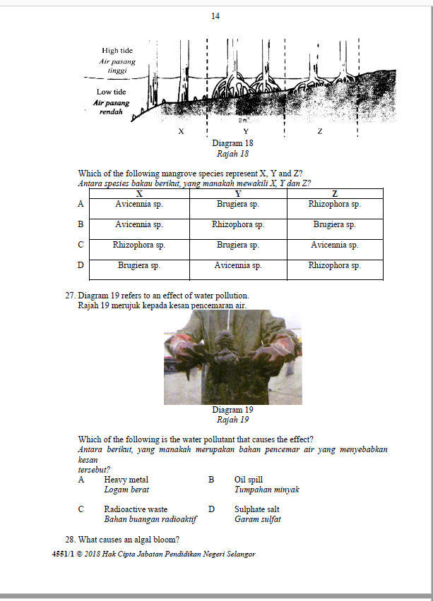

Slide 37
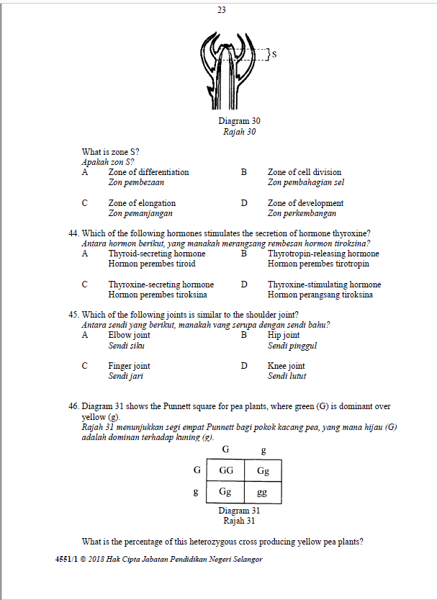

Slide 38
Form 4 Revision

Slide 39
Q1
Diagram 1.1 shows the appendicular skeleton of the human.
Name P and Q. (2%)
Name the type of tissue that made up P and justify why P is a tissue. (2%)
Explain the function of Q in relation to the movement of the arm in the direction shown in the diagram. (2%)
On Diagram 1.1, complete and label the drawing to show the antagonistic pair of muscles which involve in movement of the arm in the direction shown. (2%)
Muscular dystrophy is a condition which affects locomotion and support.
e) Suggest why the disease is more common in males than females. (2%)

Slide 40
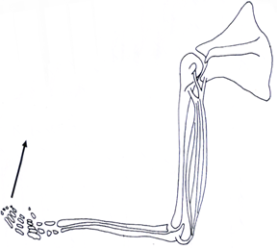
P
Q

Slide 41
Ans
P : tendon; Q : triceps muscles
P is a type of connective tissues which made up of a group of similar cells.
Q relax, biceps muscle contracts, tendon pull up , to bend the arm.
e) Males has only a single X-chromosome, the gene is linked to X-chromosome, recessive gene

Slide 42
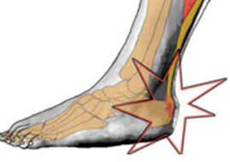
1b
Tendinitis is a common condition that affects most sportsmen and usually happens after repeated injury to an area such as the wrist or ankle. It causes pain and soreness around a joint. Some common forms of tendinitis are name after the sports that increase their risk. They include tennis elbow, golfer's elbow, pitcher's shoulder, swimmer's shoulder, and jumper's knee.
Source : From mediline plus
Diagram 1.2 shows a type of tendinitis called archilles tendinitis suffered by an athelete.
Based on the article dan Diagram 1.2, suggest how the athelete can avoid such injury in the future. (2%)

Slide 43
Ans
P1 : Do warm up before training.
P2 : To increase blood circulation/body temperature
P3 : Practice safety techniques while training
P4 : To prevent tear of tissue
P5 : Wear suitable clothing which is not too tight while training
P6 : To prevent stress to the muscles/tissue

Slide 44
Q 2
Diagram 1 shows a digestive system.
Name X and Y parts. (2%)
Explain the importance of X in digestion. (2%)
Organ Z secretes juice which contains enzymes. Explain the digestion of two nutrients that requires enzymes produced by organ Z. (4%)

Slide 45
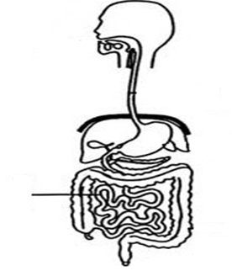
X
Z
Y

Slide 46
Ans
X : Oesophagus ; Y : Small intestine
P1 : carry out peristalsis;
P2 : to move food/bolus from mouth to stomach
c) P1 : Z secreted pancreatic amylase
P2 : to digest starch into maltose
P3 : Z secretes lipase
P4 : to digest lipid into fatty acids and glycerol
P5 : Z secretes trypsin P6 : to digest polypeptides into peptides

Slide 47
II B
Diagram 2.2 shows swelling of the appendix. The condition is called appendicitis. Appendicitis is a medical emergency that requires prompt surgery to remove the appendix. Left untreated, the appendix will eventually burst.
Suggest the consequences if the appendix burst. (2%)
Based on the diagram, explain the importance of colon. (2%)
Colon
Caecum
Swollen Appendix

Slide 48
ans
P1 : faeces comes out of the caecum
P2 : cause contamination in the abdomen
P4 : bacteria in the colon comes out
P3 : cause infection to the abdomen
P4 : faeces formation is interrupted
b) P1 : has good bacteria/lactobacillus/E. coli
P2 : that secretes antibiotics
P3 : that synthesise vitamin (B/K)
P4 : maintain the normal flora of the large intestines

Slide 49
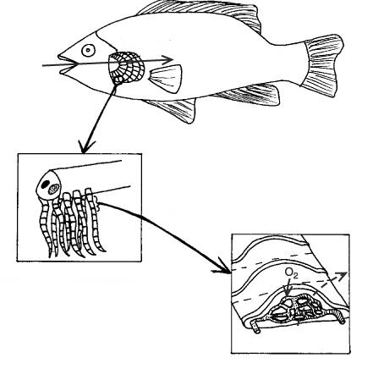
Q 3
Name structure P. (1%)
Explain how structure P is adapted for efficient gaseous exchange. (2%)
Countercurrent mechanism is one way for the fish to get sufficient oxygen for cellular respiration.
Justify how the mechanism works for the benefit of the fish. (3%)
P

Slide 50
ans
P : Gill Filaments
P1 : P is one cell thick
P2 : oxygen can diffuse easily across P
P3 : P has large total surface area
P4 : gaseous exchange can occur rapidly
c) P1 : It maximises the transport of oxygen
P2: because water flow that carry the oxygen and blood flow that carry the carbon dioxide
P3 : flow at opposite direction
P4 : This produces high concentration gradient in the blood capillary

Slide 51
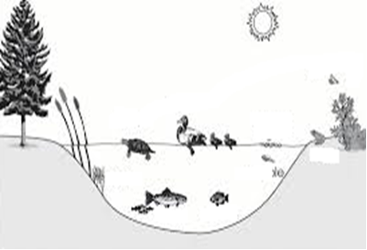
III B
In your opinion, predict what will happen to the population of fish in the pond if heavy metal wastes from nearby factories are released into the pond. Justify your answer. (2%)
If human consume the fish from the polluted pond, suggest the effect on the health of human. (2%)

Slide 52
ans
P1 : fish population decreases
P2 : because heavy metals such as lead/plumbum/mercury
P3 : damage the nervous system/brain of the fish
P4 : heavy metals are highly toxic
P5 : kill the fish/instant death of fish
B） P1 : Practise reuse, reduce and recycle concept.
P2 : to reduce usage of plastics which are non-biodegradable
P3 : use biodegradable plastics bags
P4 : Car pooling
P5 : to reduce emission of carbon dioxide/burning of fossil fuels.
P6 : Use renewable energy such as solar energy
P7 : which do not cause air pollution/global warming/greenhouse effect
P8 : Practise biological control
P9 : reduce usage of chemicals/pesticides

Slide 53
ANY QUESTIONS ?

Slide 54
THANK YOU SO MUCH

