Slide 1
Form 4 / 高一，二 Biology
SPM
KSSM Syllabus Form 4

Slide 2
WHO AM I ?
Name: Loh Han Sheng 罗汉胜
Age : 21
Subject that I taught : Biology (SPM and STPM and Foundation), Physics (SPM and STPM), Chemistry (SPM), ENG
Courses in University : MBBS (Bachelor of Medicine, Bachelor of Surgery)
Currently Year 2 student, Distinction in Physiology and Biochemistry, cGPA 3.95 in Foundation, A in Biology, Chemistry and physics, math in SPM
Previously studied in Foon Yew High School
Experienced Tutor in teaching Biology, Biochemistry and English

Slide 3
Immunity
Today Topics

Slide 4
Learning Outcomes
Three lines of body defence (SPM)
What is antigen and antibody ? (SPM)
What is the actions of antibodies ? (SPM)
Introduction to types of antibodies (Pre U)
Introduction to the concept of Self or Non Self (Pre U)
Introduction to HIV (SPM)
Active immunity VS Passive immunity (SPM) Very Important

Slide 5
What is immunity

Slide 6
Immunity
Immunity is the ability to resist an infection of a pathogen by producing a specific antibody to react against the pathogen.

Slide 7
Three lines of body defense
First line of body defence
Second line of body defence
Third line of body defence

Slide 8
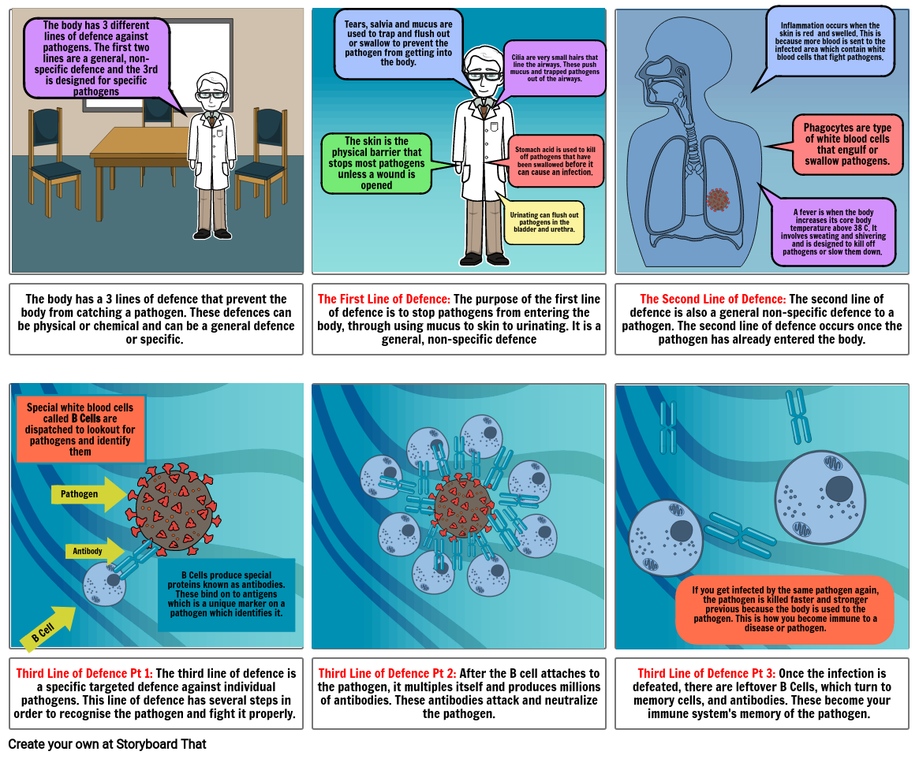

Slide 9
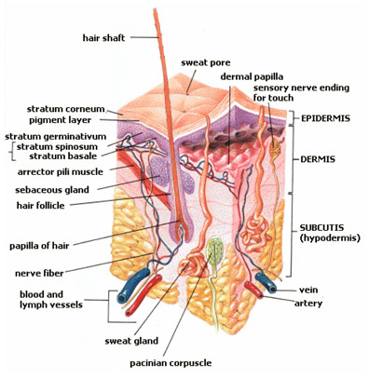
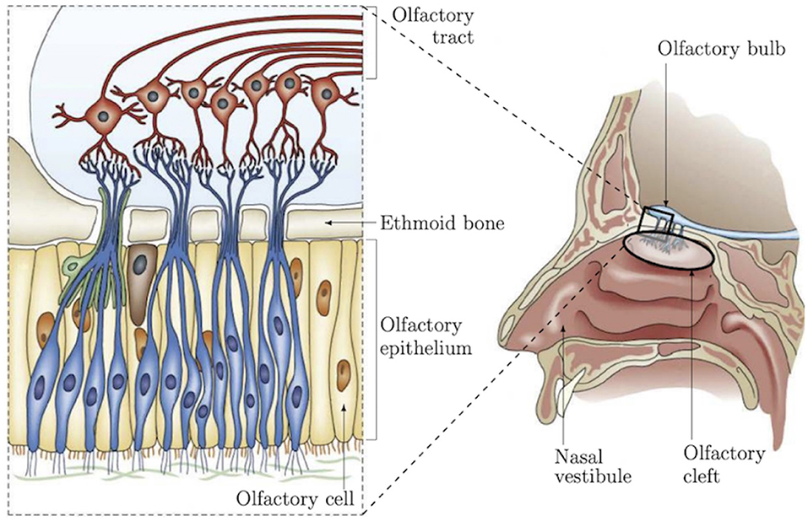
1st line of defense
Physical barrier:

Slide 10
Chemical barrier
Hydrochloric acid in stomach that destroys bacteria
Mucus produced by goblet cells on the epithelium of trachea and bronchi of lungs traps pathogens. Cilia sweeps the pathogens away from lungs.
Lysozyme in tears destroy the bacteria
Wax in ear destroy bacteria
Sebum prevents the growth of microorganisms on the skin
Sweat contains lysozyme to kill bacteria
Blood clotting caused by blood platelets

Slide 11
2nd line of defense
Fever
Inflammation
Phagocytosis
SPM version will be discussed in formal classes

Slide 12
The Concept of Set Point

Slide 13
PYROGENS
Mainly are lipopolysaccharides (eg: endotoxin) that released from toxic bacteria or degenerating body tissues. ​
It causes the set-point of the hypothalamic thermostat to rise, which then induce fever. ​

Slide 14
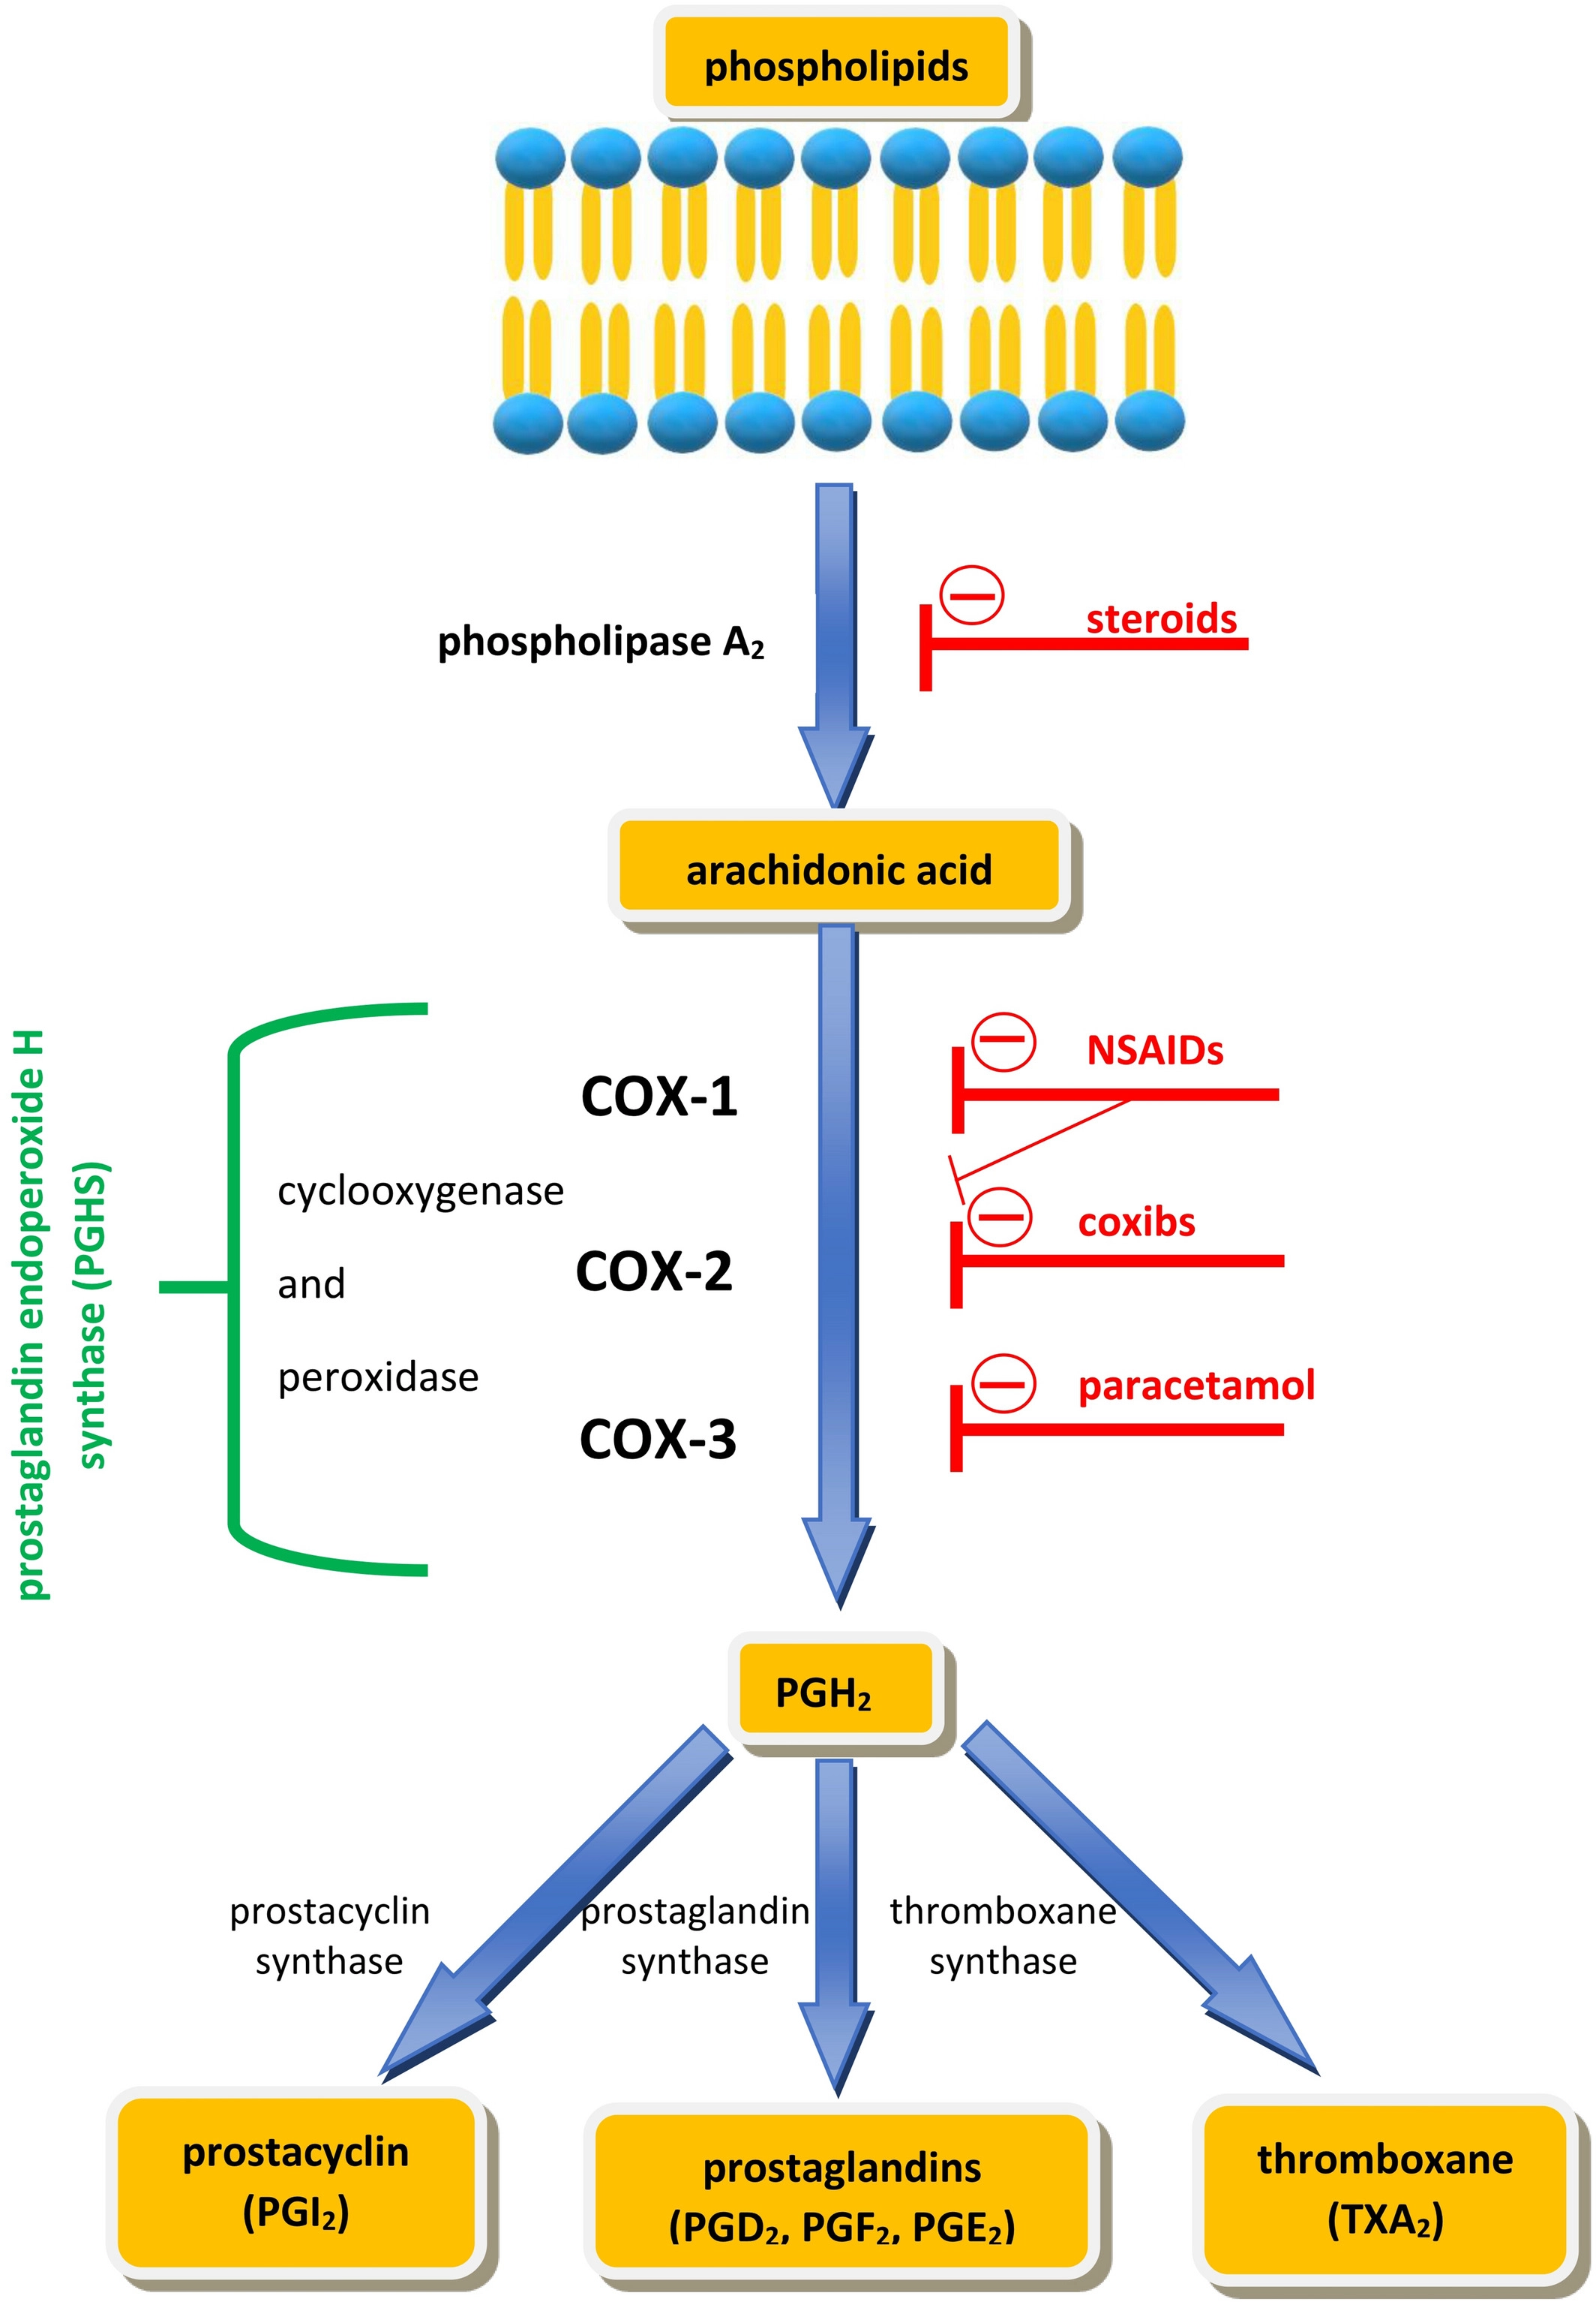
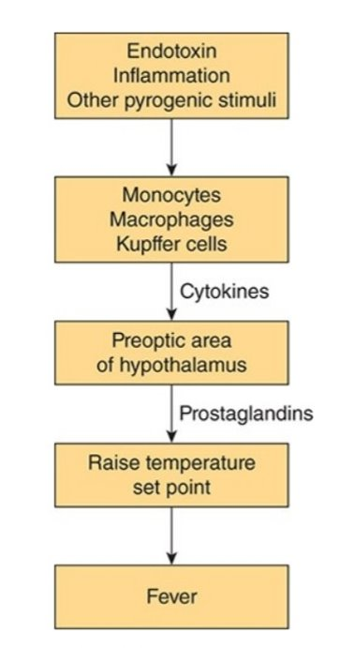
Fever

Slide 16
3rd line of defense (further details will be discussed in formal class or further education
Lymphocytes produce specific antibodies to react with particular antigens
The reaction is specific.
Antibody is always Y-shaped
The shape of antibody must be complementary with antigen.

Slide 19
Actions of Antibodies
Neutralisation – antibody combines with active sites of toxins
Agglutination – The binding sites of antibody attach to the antigens of different microbes and causing the microbes to clump together
Opsonization – The antibody molecules coat the surface of microbes, making it easier to be phagocytosized
Precipitation – Soluble antigens are bound to antibody molecules, forming a large complexes that lead to precipitate
Complement fixation – Activation of complement protein that leads to lysis of foreign cells, it comprises 30 different proteins found in plasma, only activated when there is an infection. Exp: interferon → further knowledge is required, no need for secondary level or tongkao

Slide 22
IgM
Large molecule with five Y shaped monomers linked together
First class of antibody produced when initially exposed to antigen
Does not cross placental barrier
Involved in complement activation

Slide 23
IgG
Small Monomer which easily moves out of the blood vessels and into tissue fluids
Crosses placenta, most abundant (75%)
Promotes opsonization, neutralization, agglutination

Slide 24
IgA
2 small monomers linked together
Produced mainly by cells in mucous membrane
Found in tears, sweats, saliva
Prevents the bacteria and viruses from attaching to epithelial surfaces of respiratory passages, alimentary canal, urinary and respiratory canal

Slide 25
IgD
Mainly found on cell surface of B cells
Cannot cross the placental barrier
Function still unknown maybe promoting the differentiation of B cells into plasma cells or memory cells

Slide 26
Ig E
Very small amount produced
Bind to mast cells and basophils and stimulate them to produce histamines
Allergic response
Immunity to parasitic worms

Slide 27
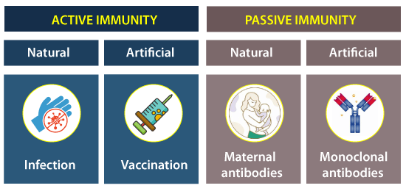

Slide 28
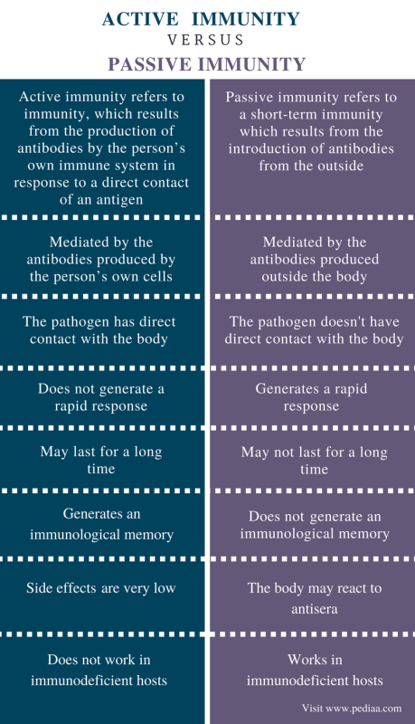

Slide 29
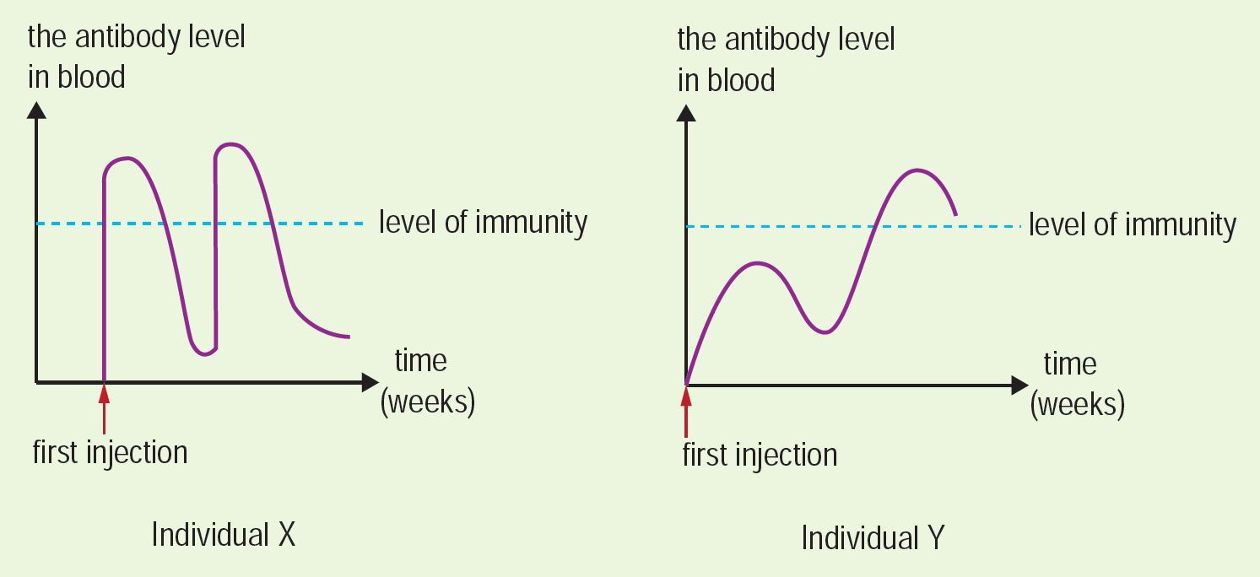

Slide 30
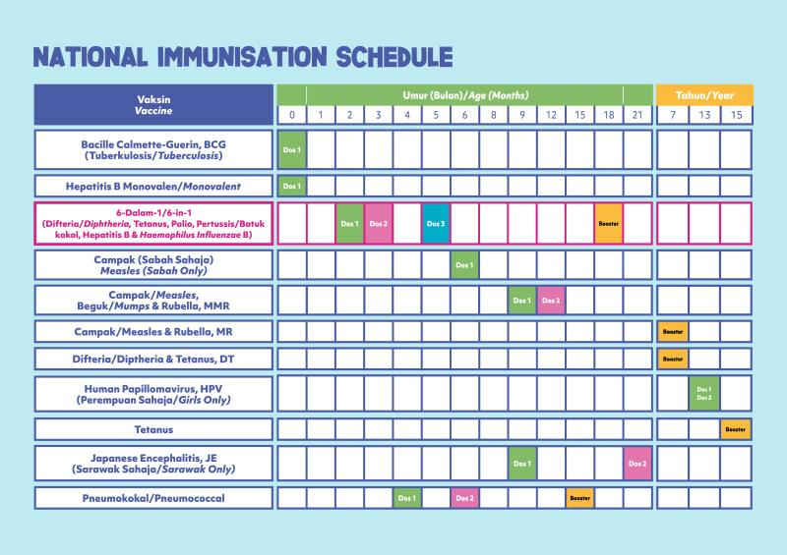

Slide 31
Self and Non-Self (Most Basic Version)
The immune system do not respond to ‘self’ antigen, because the MHC antigens already present in the early stages of embryonic development, if there are immature immune cells encounter and bind to those antigens, those cells are destroyed. The remaining immune cells that do not respond to body’s own cells retained.
Foreign tissues are regarded as non-self, so T lymphocytes attack the transplant tissues. ( deeper knowledge is required )
Tissue compatibility tests are done before transplantation of an organ.
Immunosuppression treatment are used to reduce graft rejection but patients are now vulnerable to other infections.
Xenotransplantation as a new techniques but still under research.

Slide 32
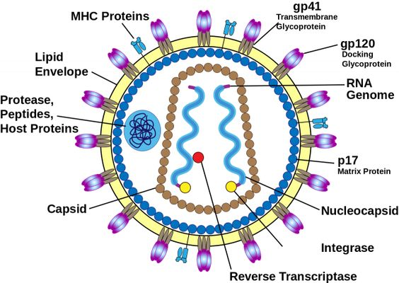
HIV (Human Immunodeficiency Virus)
It is a retrovirus, an RNA virus that uses RNA as a template to synthesizes DNA with the aid of reverse transcriptase.
There are two major strains of HIV, HIV-1 and HIV-2; where HIV-1 is more virulent form in humans.

Slide 33
HIV mechanisms (simple version), discuss in further classes

Slide 34
What is the ways of transmitting HIV virus ?
QNA sessions

Slide 35
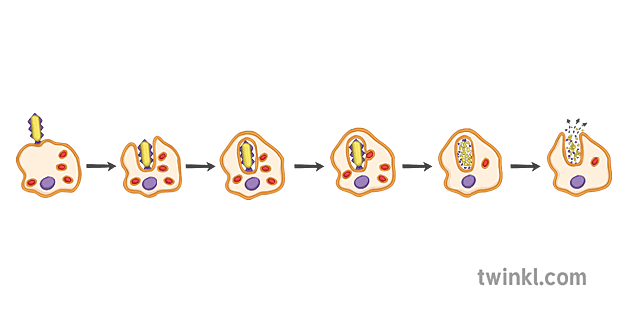
Example 1
Name one type of phagocytic white blood cell.
Why is the response involving phagocytes regarded as non-specific ?
Explain how phagocytes pass from blood into tissue fluid.

Slide 36
Ans
Neutrophils / monocytes/ macrophages
It does not involve targeting specific pathogens. / It does not exhibit specificity in the process.
Phagocytes are able to squeeze through the capillaries by changing shape and through the pores in the walls of capillaries.

Slide 37
Example 2
Pathogenic bacteria and viruses make a person feel ill. Why do bacterial infections make a person feel ill ? A type of disease caused by bacteria is normally treated with antibiotic X. However, in recent years, the diseases become less treatable when given antibiotic X. Table below shows the number of patients that cannot be treated when given antibiotic X between 2005 and 2021.
Why the number of patients that cannot be treated by antibiotic X increase ?
Why doctor should not be longer prescribe antibiotic X to patients ?
Why doctor advise the patient to take full course of antibiotics prescribed ?
Years | Number of untreated patients
2005 – 2015 | 27
2016 – 2019 | 35
2020 - 2021 | 58

Slide 38
Ans
Bacteria produce immune response in our body.
Antibiotic X has become less effective in killing the bacteria. Maybe due to the overuse of the antibiotic, bacteria has mutated and become resistant form to the antibiotics.
Antibiotic X may not longer be able to kill the bacteria.
Bacteria that survive from the treatment, may mutate and become stronger and resistant to the antibiotic.

Slide 39
Example 3
Based on the two graphs, answering the following questions:
State two differences between X and Y immunity.
Name type X and Y immunity. Name the substances injected into individuals X and Y.
Why second injection is necessary in Y ?
Define vaccine and antiserum.

Slide 40
Ans
X immunity is immediate but temporary; Y immunity is slow but permanent.
X : artificially acquired passive immunity, Y : artificially acquired active immunity
X : antiserum, Y : vaccine
To increase antibody production to a level of immunity that protects the person against the diseases.
Vaccine is a preparation of weakened, dead and non-virulent forms of a pathogen that is not harmful to person receives it and stimulates the body to produce antibodies capable of binding to the antigen.
Antiserum is serum containing antibodies that are obtained from a donor.

Slide 41
ANY QUESTIONS ?

Slide 42
THANK YOU SO MUCH

